Slide 1

Custom bootcamp – IDA
Smriti Ravindran

Slide 2

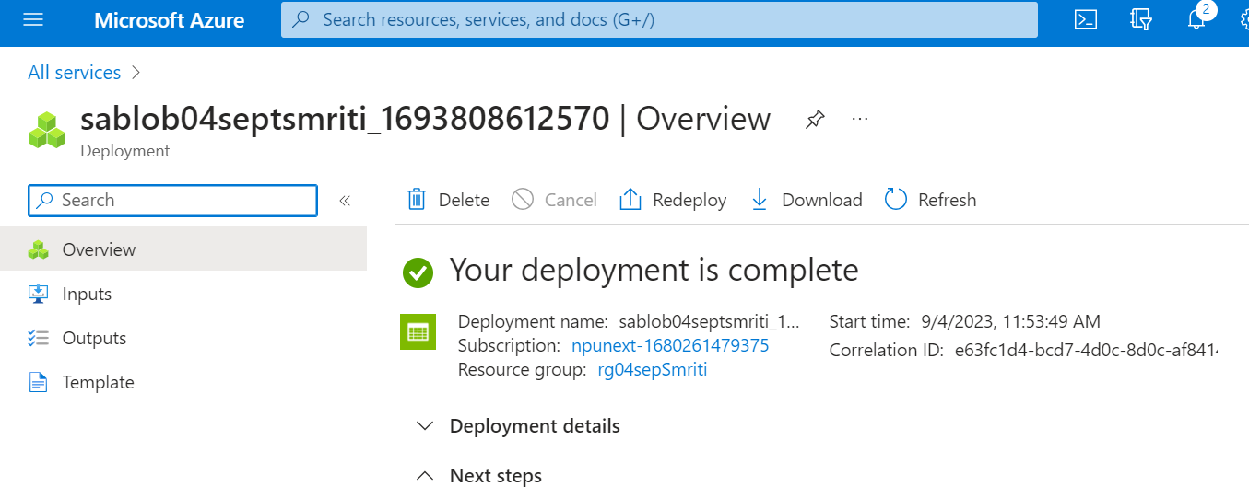
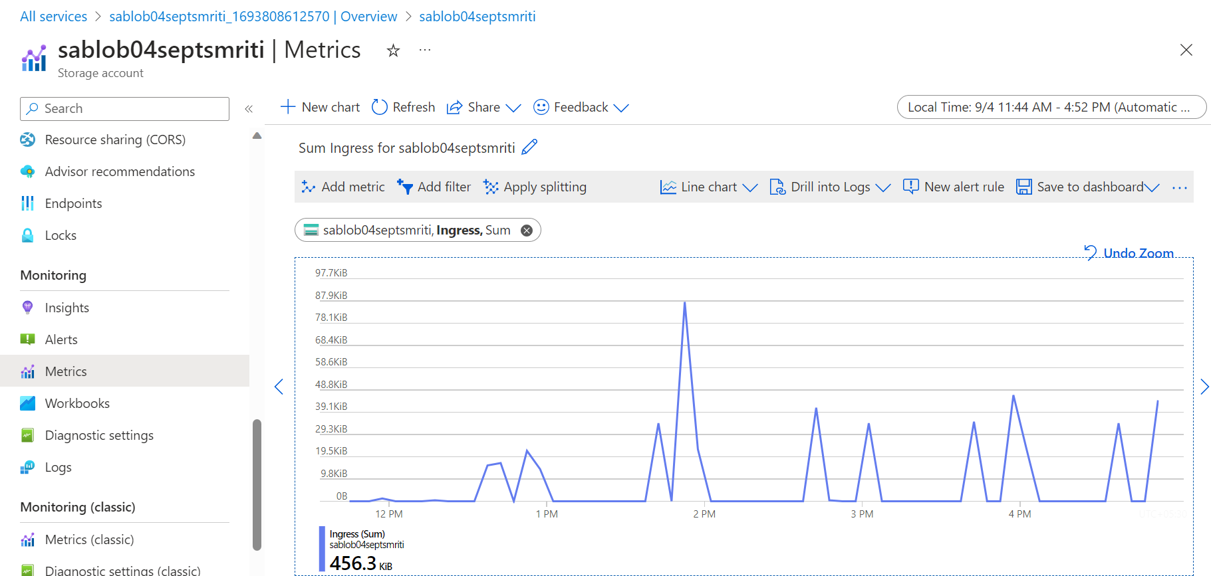
Microsoft Azure storage types BLOBs
- Created blob storage , under which we set alerts with a certain threshold value
Observed the metrics for Ingress and Egress .
The topmost image depicts the completion of deployment (blob)
The bottom image represents the metrics graph.

Slide 3
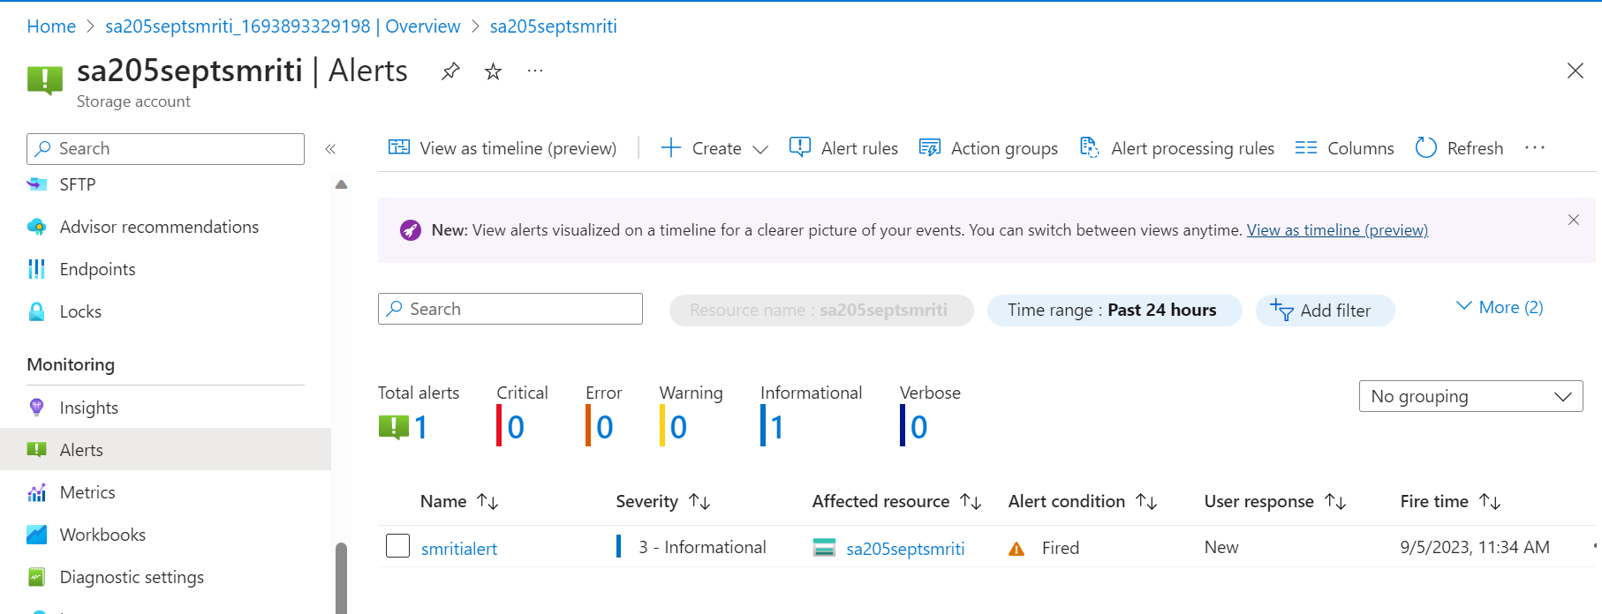
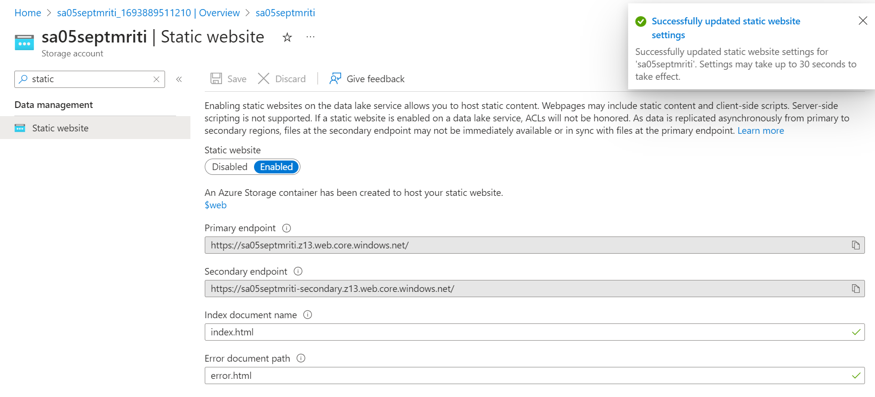
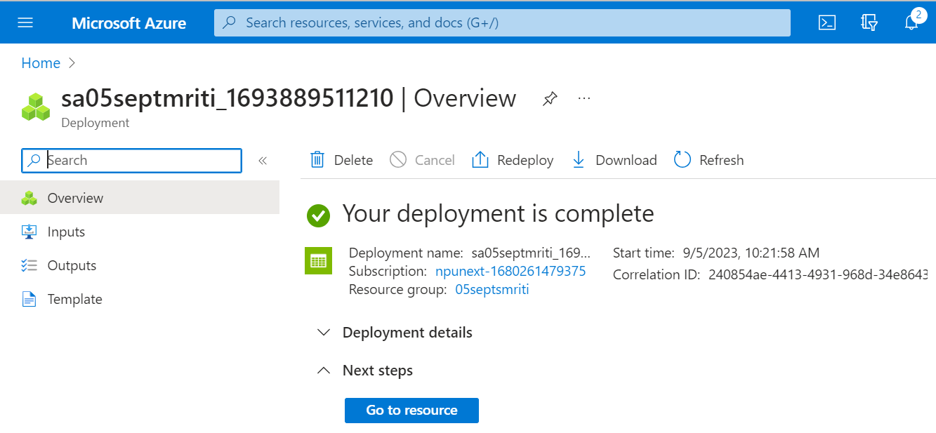
STATIC WEBSITE
Created a static website.
Created required alerts with threshold value to check specific parameters.

Slide 4
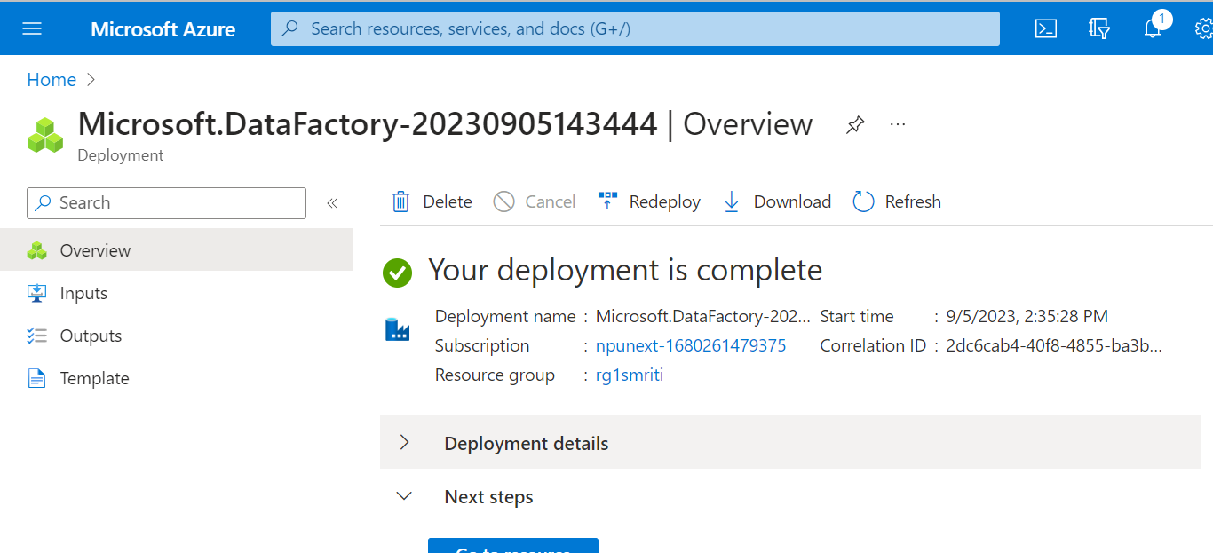
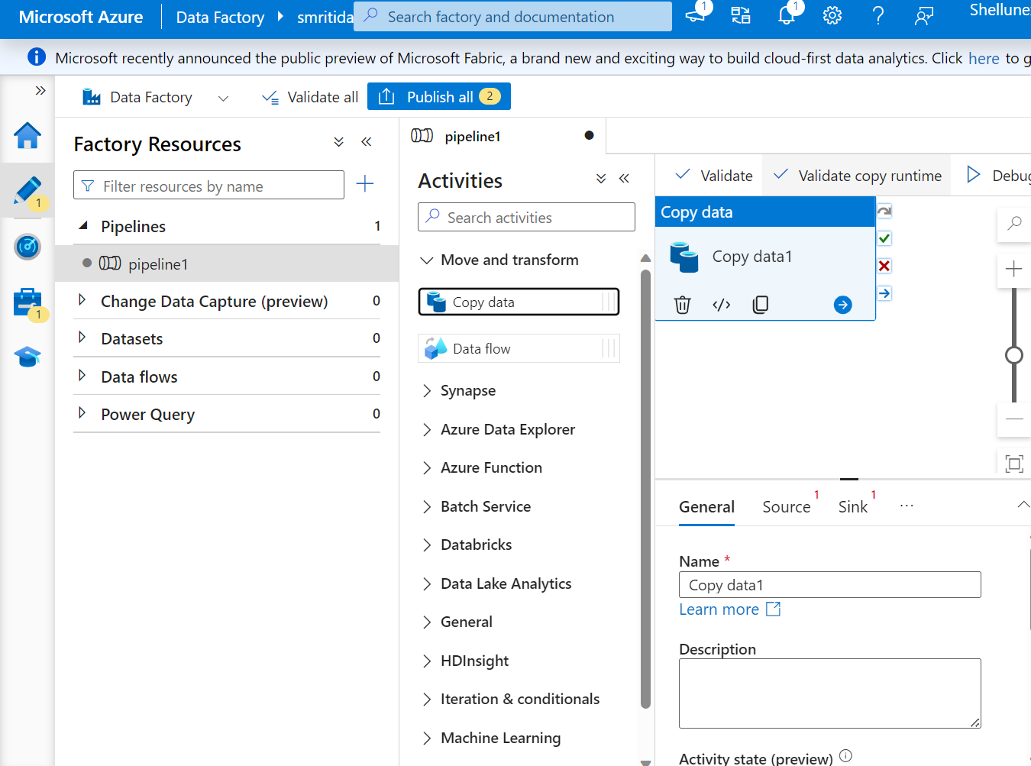
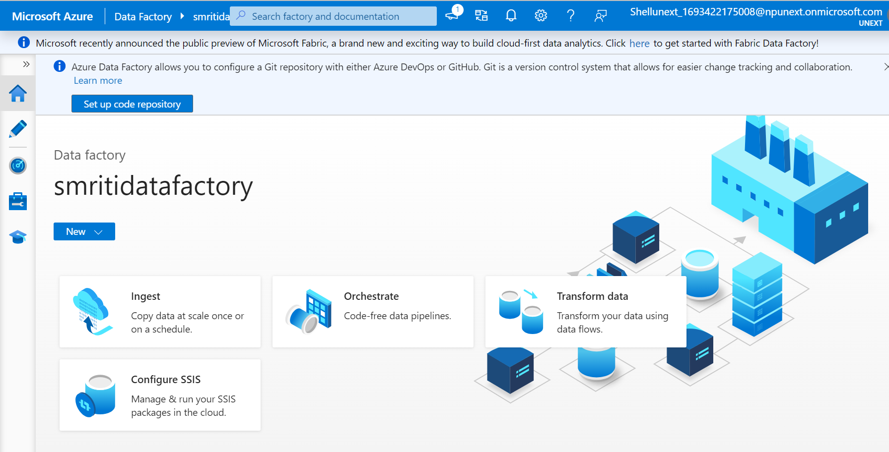
AZURE DATA FACTORY
Used azure data factory to create datasets, form pipelines in order to copy data from input container to the output container (storage account).

Slide 5
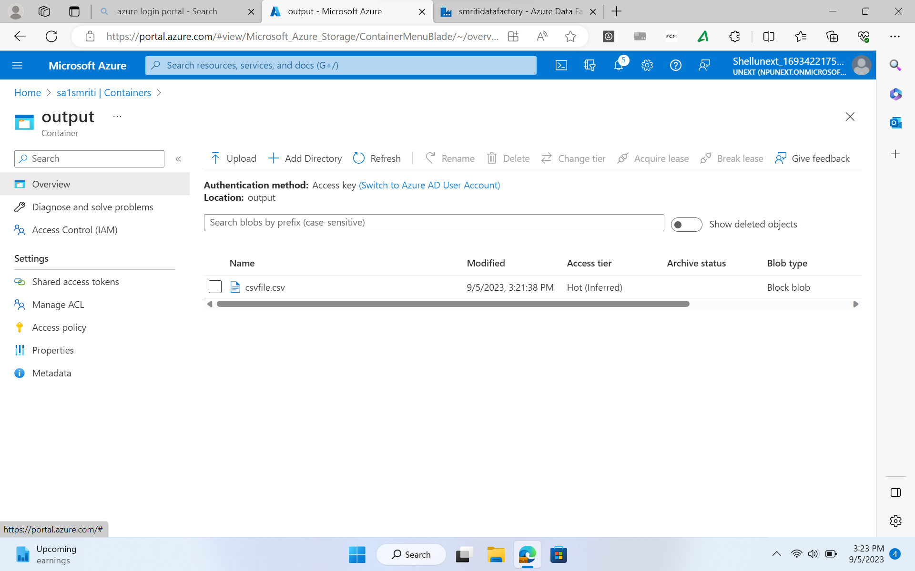
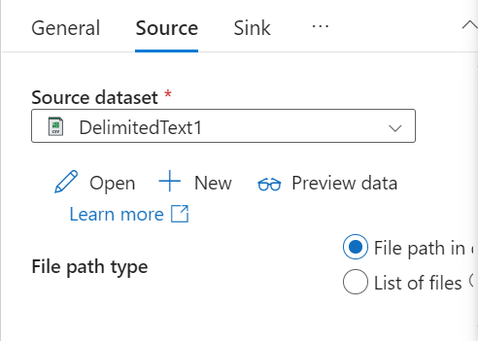
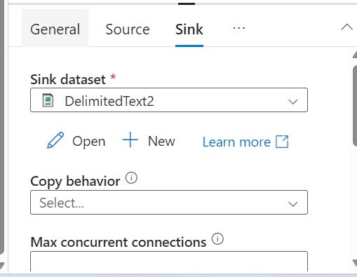
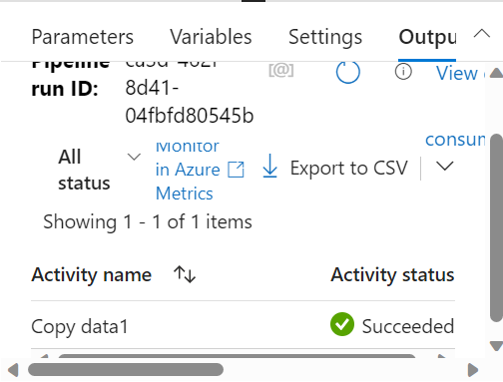
These screenshots represent Containers and Datasets created for azure data factory

Slide 6
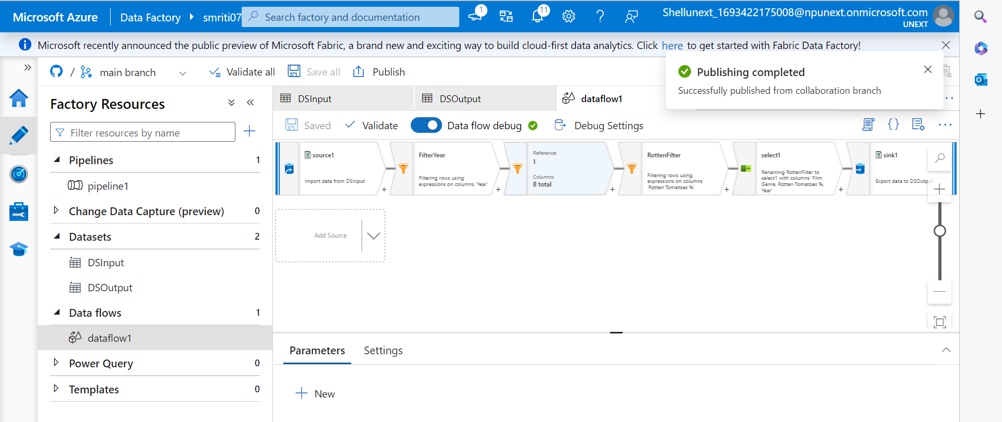
Created a data flow pipeline that filters data from the input container and stores it to the output container (storage account) using azure data factory

Slide 7

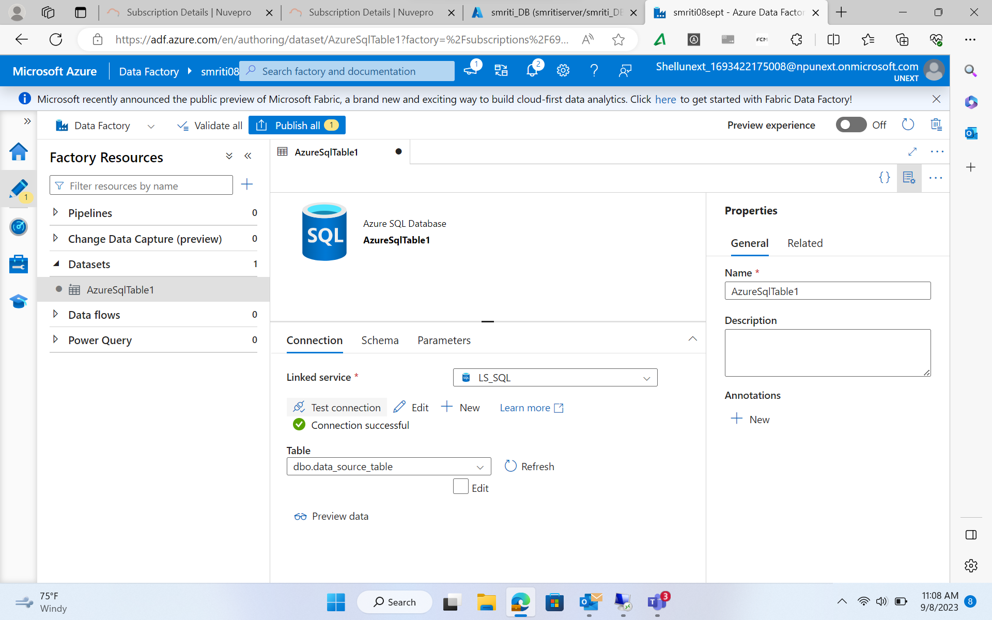
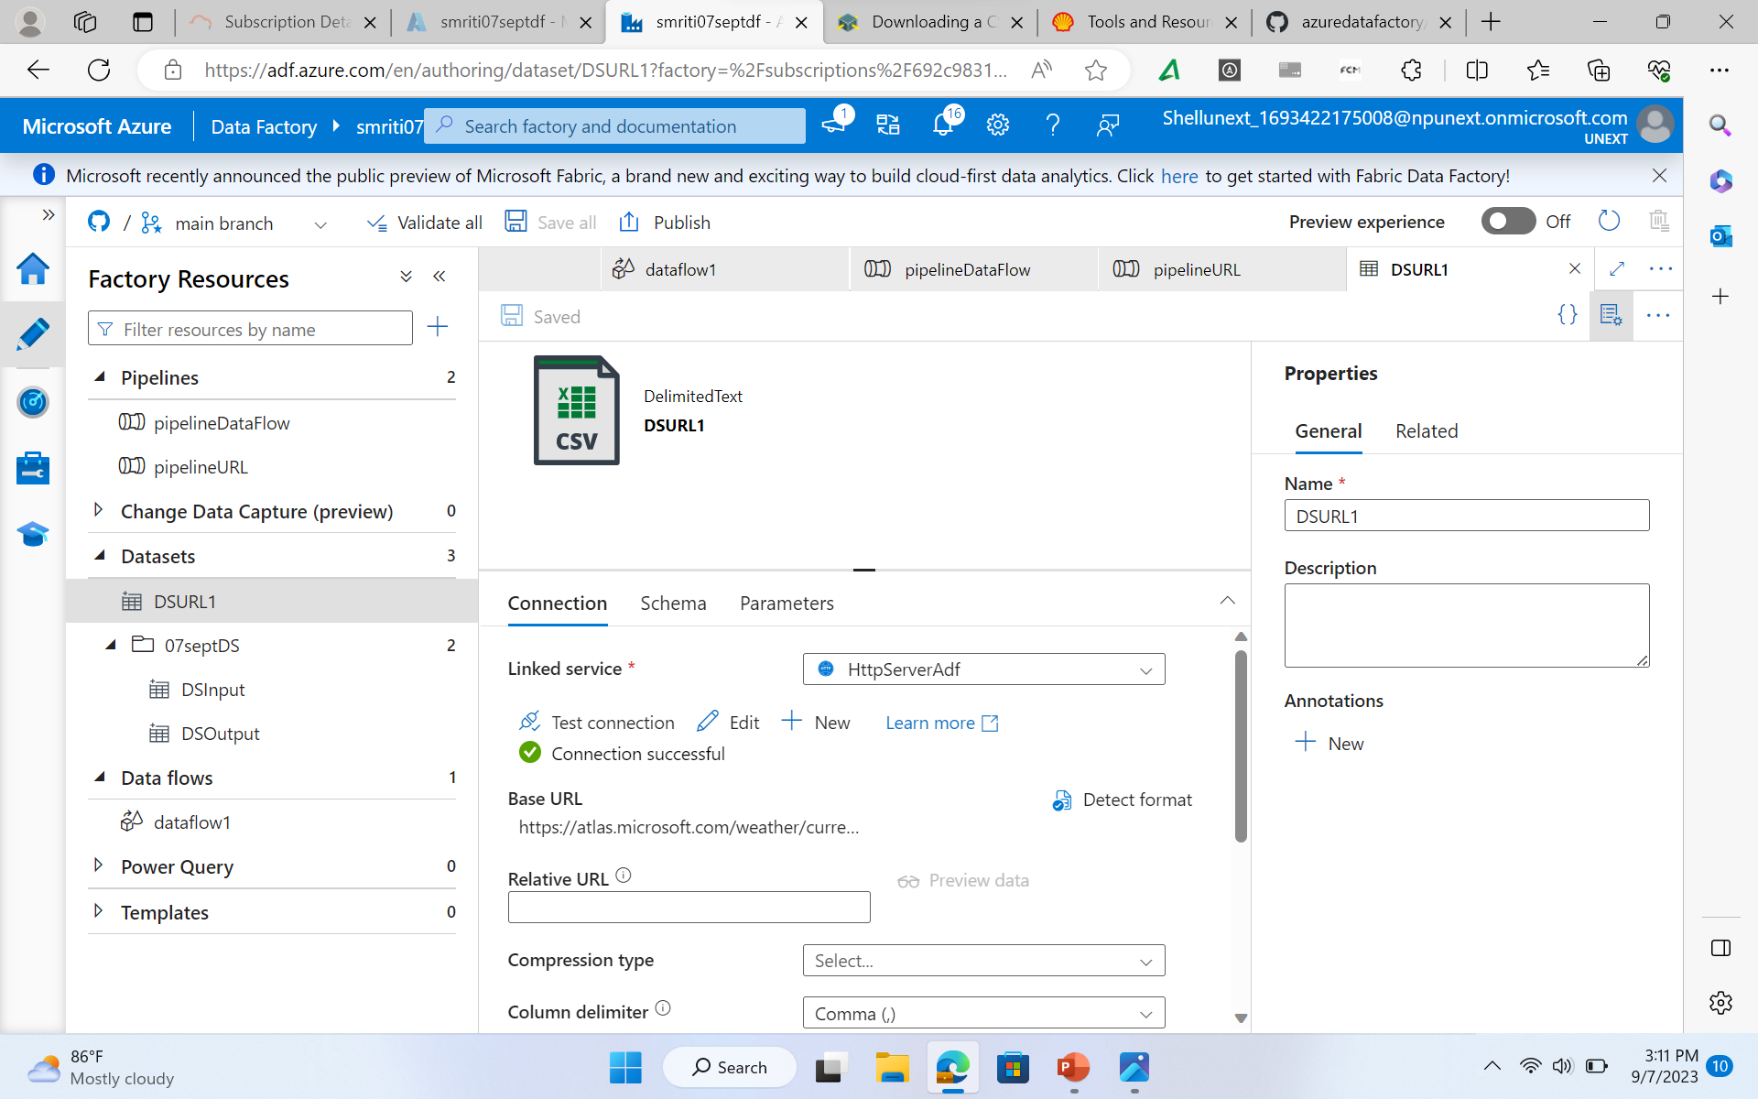
Created linked services for various different kinds of datasets, namely blob storage, Gen2, SQL and Http to created related datasets and transfer them as and where required with pipelines using azure data factory

